Slide 1
Drug Availability in Canada
Improving access to information using public data

Slide 2
Background
“The escalation in shortages of prescription drugs in the past few years and the ongoing disruptions to supply experienced in Canada and globally are matters of grave concern to the Canadian Medical Association”
“In the United States the number of drug shortages from 2006 to 2010 grew by more than 200 percent.”
“A CMA survey of physicians in September 2012 found that 66% of respondents indicated that drug shortages have gotten worse since 2010 and 64% stated that the shortages have had consequences for their patients or practice. Similarly, the results of the 2012 Canadian Pharmacists Association survey of pharmacists found that over 91% of pharmacists had been inconvenienced by shortages and 51% indicated that patients’ care had been compromised.”
Quotes from CMA Policy position statement on prescription drug shortages in Canada

Slide 3
More background
Drug shortages the new normal and hard to fix
Drug shortages: Patients and healthcare providers are all drawing the short straw
See here for a list of articles.

Slide 4
Plenty of data but no information
It is now mandatory for manufacturers to report shortages and this data is available at drugshortagescanada.ca
But this is just data and falls far short of information. For example, it may report that the 250 count bottle of APO-Fluvoxamine has been discontinued. But it fails to tell you anything about the 100 count bottle by that manufacturer or how many other forms by other manufacturers of the same medication are available.
In other words, there is no information available on drug availability. Shortage and discontinuation data without the necessary context is of little value.

Slide 5
Where are people getting information now?
Patients and subsequently physicians appear to be getting information via Facebook.
A patient goes in to get a refill on their prescription. The pharmacist says they can’t get it right now. The patient goes on Facebook and mentions this on a medically-relevant group. Then patients in the group on the same medication go to their pharmacists, discover that what they heard is true and then book appointments with their physician. Physicians are flooded with requests for appointments and scramble to get information on the availability of alternatives while at the same time booking all of these appointments.
This inefficient & expensive process is well-documented in surveys done by the CMA.

Slide 6
The big idea
Build a reporting mechanism to provide pharmacists and physicians with reliable information on the current availability of pharmaceutical medications.
Build up a database over time to calculate and report the accuracy with which manufacturers estimate the duration of shortages.
Build predictive modeling to enable physicians to anticipate shortages and prescribe alternate medications when appropriate.

Slide 7
Who needs this information
Physicians to aid with patient care
Pharmacists to aid with patient care
Pharmaceutical suppliers (intermediary between manufacturers and pharmacies) to update their system to reflect accurate information.
Provincial and federal governments to make informed decisions on drug formularies.

Slide 8
A note on ethics
Stockpiling of medications is a danger. For this reason, the general public is not a target audience for this information.
Different audiences require different information and the risk of stockpiling should be considered for each audience.

Slide 9
Data Source #1: drugshortagescanada.ca

Slide 10
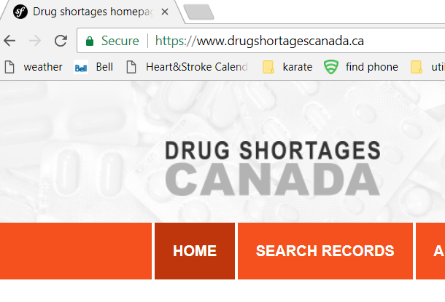
Drug shortage/discontinuation data
www.drugshortagescanada.ca
Click here to access data

Slide 11
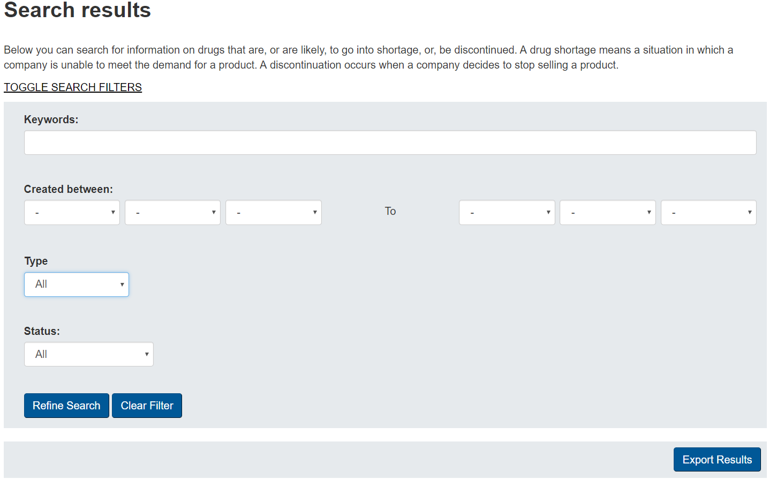
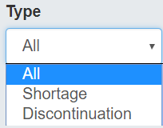
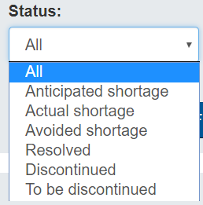
Can we automate the download process?
There are two types of data files with slightly different fields.
There are six drug statuses.
Click to export csv file
Refine search before exporting

Slide 12
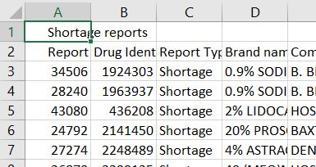
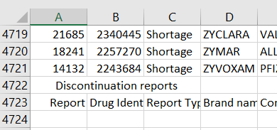
Shortage Data Extracts
Have 1 ‘extra’ line at the top
Have 2 ‘extra’ lines at the bottom
Can we automate deleting extra lines?

Slide 13
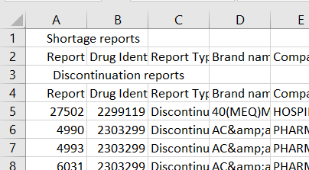
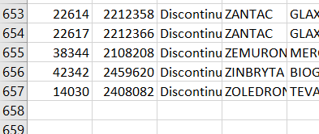
Discontinuation Data Extracts
Have 3 ‘extra’ lines at the top
Have no ‘extra’ lines at the bottom
Can we automate deleting extra lines?

Slide 14
This is the drug-state information obtained from canadadrugshortages.ca
Shortage
Discontinued
Anticipated
To Be Discontinued
Actual
Discontinued
Avoided
Resolved

Slide 15
Data Source #2: The Canadian Drug Product Database

Slide 16
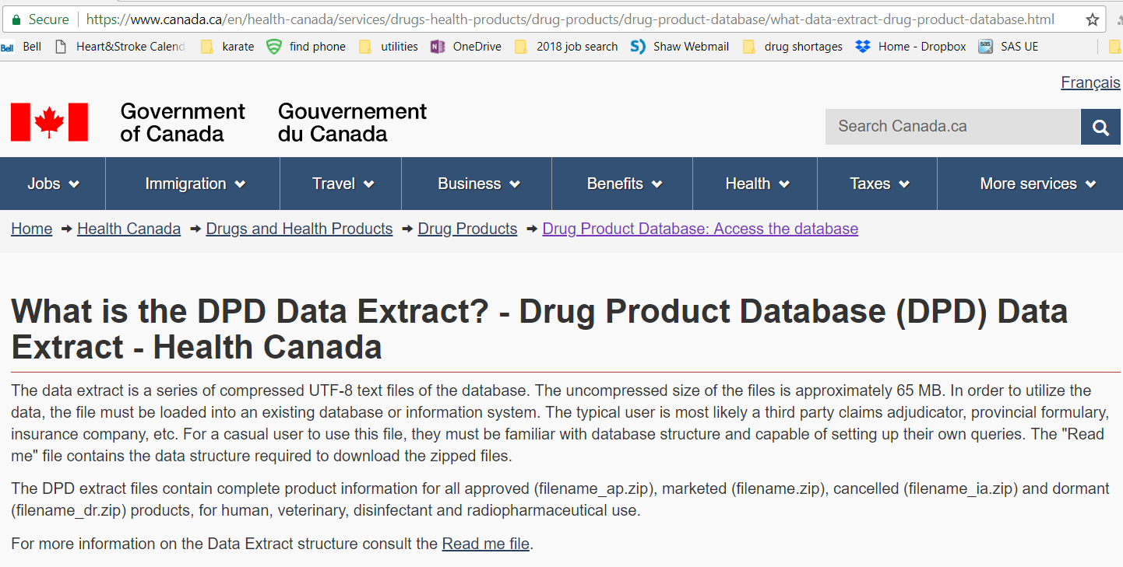
Hyperlink to website

Slide 17
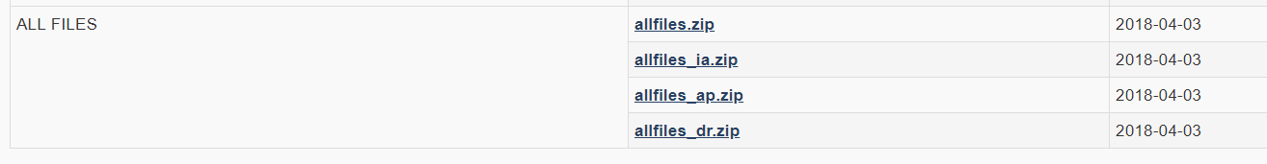
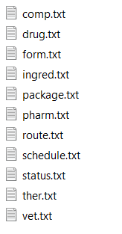
Canadian Drug Product Database
Scroll down to the bottom and select allfiles.zip
Can we automate the download process?
Extract the files

Slide 18
This is the drug-state information obtained from the CDPD
Approved
Marketed
Dormant
Cancelled
Pre-Market
Post-Market

Slide 19
Putting it all together

Slide 20
The two data sources identify all possible states
Approved
Marketed
Dormant
Cancelled
This important state can only be calculated by merging the two data sources together.
THIS is what physicians, pharmacists and patients REALLY need to know.
Available
Shortage
Discontinued
Pre-Market
Post-Market
Anticipated
To Be Discontinued
Actual
Discontinued
Some of these would be recategorized under ‘Available’.
Avoided
Resolved

Slide 21
Group states to better reflect availability
Available
Available
Anticipated Shortage
Soon to be unavailable
To Be Discontinued
Actual Shortage
Discontinued
Dormant
Unavailable
Cancelled

Slide 22
What can be done with the data?
Build reporting of current availability.
Use Tableau public to start but pursue possibility of app development.
Find influencers in the pharmaceutical supply chain (pharmacies, hospitals, suppliers) that want to have this capability built in to their systems (because they all currently have flawed information!)
Build visual analytics to display historical availability. This will help reveal pending shortages.
Tableau public to start but pursue possibility of app development.
Pharmaceutical companies often go in and edit their estimates of shortage durations. Need to build database that captures these changes. Once we have sufficient data over time build KPI to measure the accuracy of pharmaceutical company estimates. Provide reporting on this.
Build predictive models to provide advanced notice of increased risk of shortages.
Tech chosen (SAS or R or Python) may depend on tech decisions made prior to this point.

